Slide 1

Public Opinion Polls:
What Journalists Should Know

Slide 2
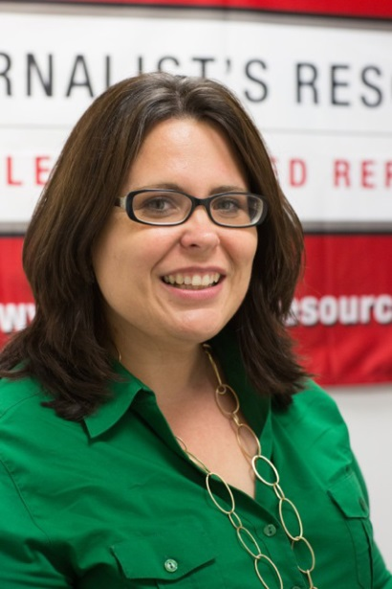

Your presenter
Denise-Marie Ordway is managing editor of Journalist’s Resource at Harvard’s Shorenstein Center for Media, Politics and Public Policy.

Slide 3
Today’s plan
Quick overview of polls
Spotting polls you can trust
What can go wrong with polls?
Questions journalists should ask
Dos and Don’ts for journalists
Understanding margin of error

Slide 4
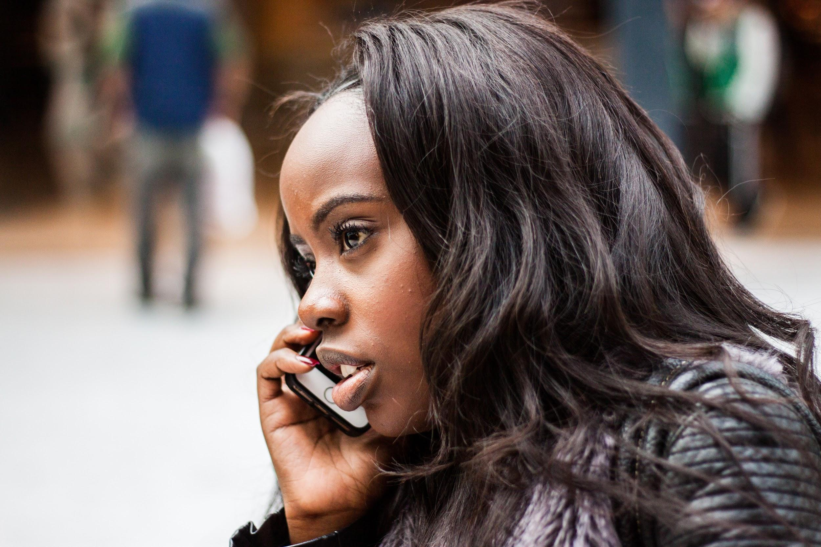
Polls: What’s out there?
Internet polls
Man-on-the-street polls
Push polls
Exit polls
Professional polls
(Photo by Ehimetalor Unuabona/Unsplash)

Slide 5
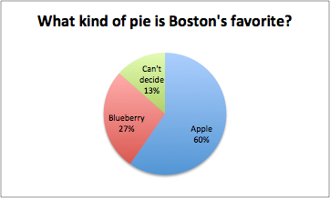
Why report on polls?
Source of information on public interest, attitudes and behaviors
Reliable if well done
Public pays attention
Viewed as a predictor of election results
Easy visual element for issue coverage

Slide 6
What can you trust?
Random selection of participants
Participants are representative of the group that pollsters are trying to understand
Larger number of respondents
Reported methodology and margin of error
  (Having more than 1,000 participants typically reduces your margin of error to about +/- 3 percentage points.)
Questions use neutral language and understandable terms
Claims made are based on findings/questions asked

Slide 7
What can go wrong?
If people weren’t randomly selected …
  Example: Let’s say women under age 30 constitute ¾ of the sample for a poll about healthcare reform.
If it’s an internet or web-based poll or survey…
  Those who feel passionate about the topic may be more likely to respond.
  Visitors to specific websites may be more likely to respond.
  People with better internet service or more leisure time may be more likely to respond.
  People can easily misrepresent themselves.

Slide 8
What else can go wrong?
Problem with non-random sample: Hard to know how meaningful the findings are and whether they apply to the general population.
Red flag: If methods are not published or made public or if they are vague.
Cause for pause: If a non-expert conducted the poll.
Note: Funding sources.

Slide 9
What else can go wrong?
Loaded or biased questions
  The way you ask a question can influence results.
  (Do you prefer fruit or ice cream? Do you prefer fruit or ice cream for breakfast? When you’re eating with colleagues from work, do you prefer fruit or ice cream?)
Small number of respondents
  Remember that the larger the number of (randomly selected) participants, the more confident you can be that the result can be generalized to the population.

Slide 10
What else can go wrong?
Question order (Example: Do you prefer fruit or ice cream? Did you know research indicates adults with lower education levels prefer ice cream?)
Vague terms (Examples: “Hate speech” and “junk food”)
Claims are not supported by results (The question is: Do you prefer fruit or ice cream? The claim is: Most adults living in France say they prefer fruit over ice cream because France produces the best strawberries and blueberries in the world.)

Slide 11
What should you ask?
How were people chosen?
  Do people who participated possibly have different views than the public overall?
Who paid for it?
  Was it paid for by an interest group looking for a particular outcome?
Who conducted it?
  Was it conducted by a reputable polling company?
How many people responded?
  Too few people will lead to a large margin of error and low confidence in how well responses represent the full population.
Who participated (demographic characteristics, region of the country, political party, etc.)?
  Polls that target specific groups should only be generalized to those groups.

Slide 12
What should you ask?
What’s the margin of error?
What questions were asked?
  The wording of questions and their order can influence results.
Can I get a copy of the questions in the order they were asked?
What was the response rate?
What might have gone wrong with the survey?

Slide 13
Dos and Don’ts for Journalists
DON’T give equal credence to all polls.
DON’T report on polls without context.
DO ask for details about a poll.
DO explain conflicting polls (different results for the same question over time or different results from different polling organizations).
DO consider margin of error.

Slide 14
Margin of Error
Suppose 50% of Serbians like chocolate ice cream better than vanilla ice cream, and 50% like vanilla better than chocolate.
In a sample of 1,000 people chosen randomly, you wouldn’t expect to get exactly 500 people who prefer chocolate and 500 who prefer vanilla. But we shouldn’t be too far from getting 500 in each category.

Slide 15
Margin of Error
How likely and how close?
If we randomly ask 1,000 people, there’s a 95% chance that between 469 and 531 people will say they prefer vanilla.
If you don’t know the actual number of people who like vanilla or chocolate, you use data collected by a poll to make an inference. The inference is a range of percentages of all people who like vanilla more. That interval is likely to contain the true value of people who prefer vanilla.

Slide 16
Margin of Error
Suppose vanilla is preferred by 55% of Serbians. Conduct many polls, each with 1,000 people.
.55
(About) 19 out of 20 times, the confidence interval will contain the “true value.”

Slide 17
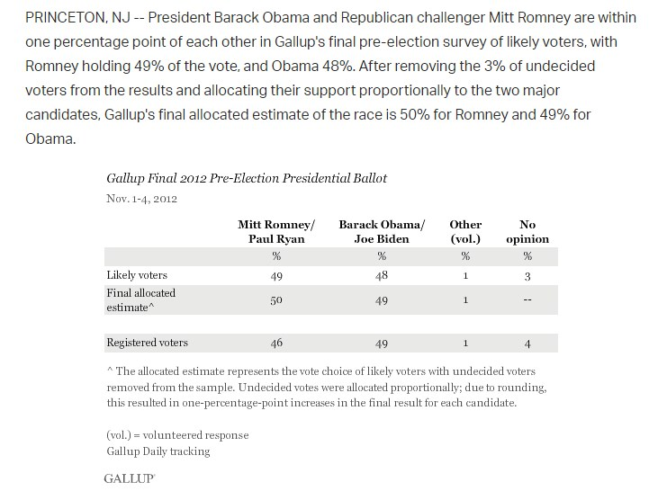
(Source: http://news.gallup.com)

Slide 18
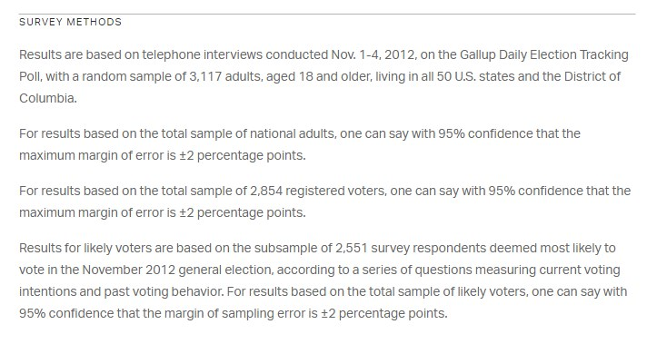
(Source: http://news.gallup.com)

Slide 19
Additional resources:
JournalistsResource.org
Pew Research Center
American Association for Public Opinion Research
Contact Denise-Marie Ordway
denise-marie_ordway@hks.harvard.edu
@DeniseOrdway

